Slide 1
Multiculturalism Session 09
Course : CB Pancasila
Effective Period : 2017

Slide 2
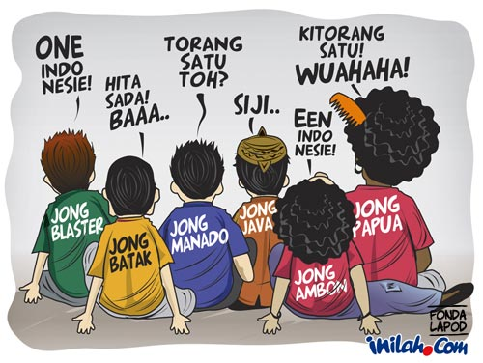
Student will be able to explain the relevance of multiculturalism in Indonesia
Learning Objectives

Slide 3
Monism, Culturalism and Multiculturalism
Monism
There is only one single value in terms of reaching the truth (although diverse human cultures)
Same morality in terms of human, natural structure of the world, the idea of ​​God that unites all human beings from different cultural backgrounds
Naturalism (same human nature) and pluralism (cultures can be universalized)

Slide 4
Culturalism/Pluralism
Human social reality is different
Vico : geography , history and community organizations make different communities
Montesquieu: divide European-Non European societies (diversity arises because many human cultures develop slowly and absolute)
Herder: experience of each community is different, different relationship with nature, creativity-innovation different, different verbal language in communication)

Slide 5
Multiculturalism
Monism and pluralism is not quite up to conceptualize human and cultural
We still have to learn to live together (H.G Gadamer )
The philosophy of multiculturalism: a critical reflection on the reality of pluralism (ethnicity, religion, class , ethnicity, race)
Multiculturalism: cultural & construction strategy perspective justifying cultural diversity, awareness of cultural differences and appreciation of diversity

Slide 6
Nature of Multiculturalism
Multi means a lot; culturalism means cultural ideology
The outlook accommodate many streams and different culture ideologies
Multiculturalism tolerate the differences, supporting diversity, fighting for the various interest groups and cultures, including minority groups in the various dimensions of social (ethnic, racial, religious, political, cultural, gender, etc)

Slide 7
Multiculturalism in Indonesia
Multiculturalism cause by the background of geographic climatic, natural environment
Respect and recognition of different cultural identities need to be fought
Cultural differences is a grace
Multiculturalism should be placed in the cultural strategy to a better life

Slide 8
The Relevance of Multiculturalism to NKRI
28 October 1928
17 August 1945
Konghu Chu becomes a new religion in reformation era
Civilization to the ‘Good Life ‘in the Future of Indonesia
→ Further reflections of the importance of multiculturalism in Indonesia is a must!

Slide 9
Discussion
What do you think about multiculturalism in Indonesia?
And how do you respond it?

Slide 10

Case Study
Read the article based on the following link ….
And give your opinion
Indonesia dan Akomodasi Multikultural
http://nasional.kompas.com/read/2017/04/06/19121881/indonesia.dan.akomodasi.multikultural

Slide 11
Question and Answer
?

Slide 12
References
Tim Penulis CB: Pancasila (2014). Diktat Kuliah Character Building: Pancasila. Binus University: CBDC, 000
Belajar ilmu sosial: http://khairulazharsaragih.blogspot.com/2013/01/masyarakat-multikultural-di-indonesia.html
Gambar multikulturalisme: https://sociologypolitik.blogspot.co.id/2015/05/makalah-pendidikan-multikultural.html
Case Study & picture:
http://nasional.kompas.com/read/2017/04/06/19121881/indonesia.dan.akomodasi.multikultural

